Slide 1
2016 Society of Toxicology
Mechanisms Specialty Section
Award Presentation

Slide 2
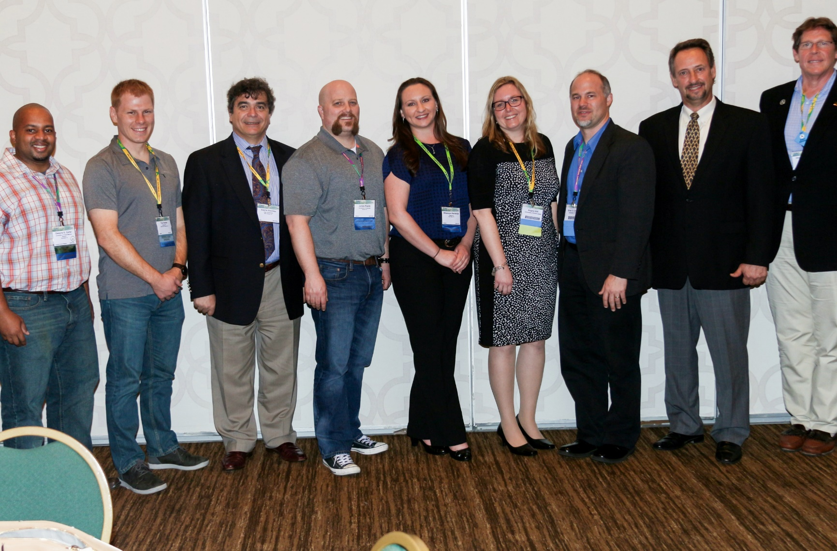
2015-2016 Mechanisms Officers
Left to Right: Student Representative Dwayne E. Carter, former UTMB, current Organovo; Postdoctoral Representative Tod A. Harper, former Linus Pauling Institute, current Amgen; Past President Vasilis Vasiliou, Yale University; Senior Councilor James R. Roede, University of Colorado; Secretary/Treasurer Rhiannon N. Hardwick, Organovo; Vice President Angela L. Slitt, University of Rhode Island; Vice President-Elect Brian S. Cummings, University of Georgia; President Richard R. Vaillancourt, University of Arizona; Junior Councilor Daniel D. Petersen, USEPA

Slide 3
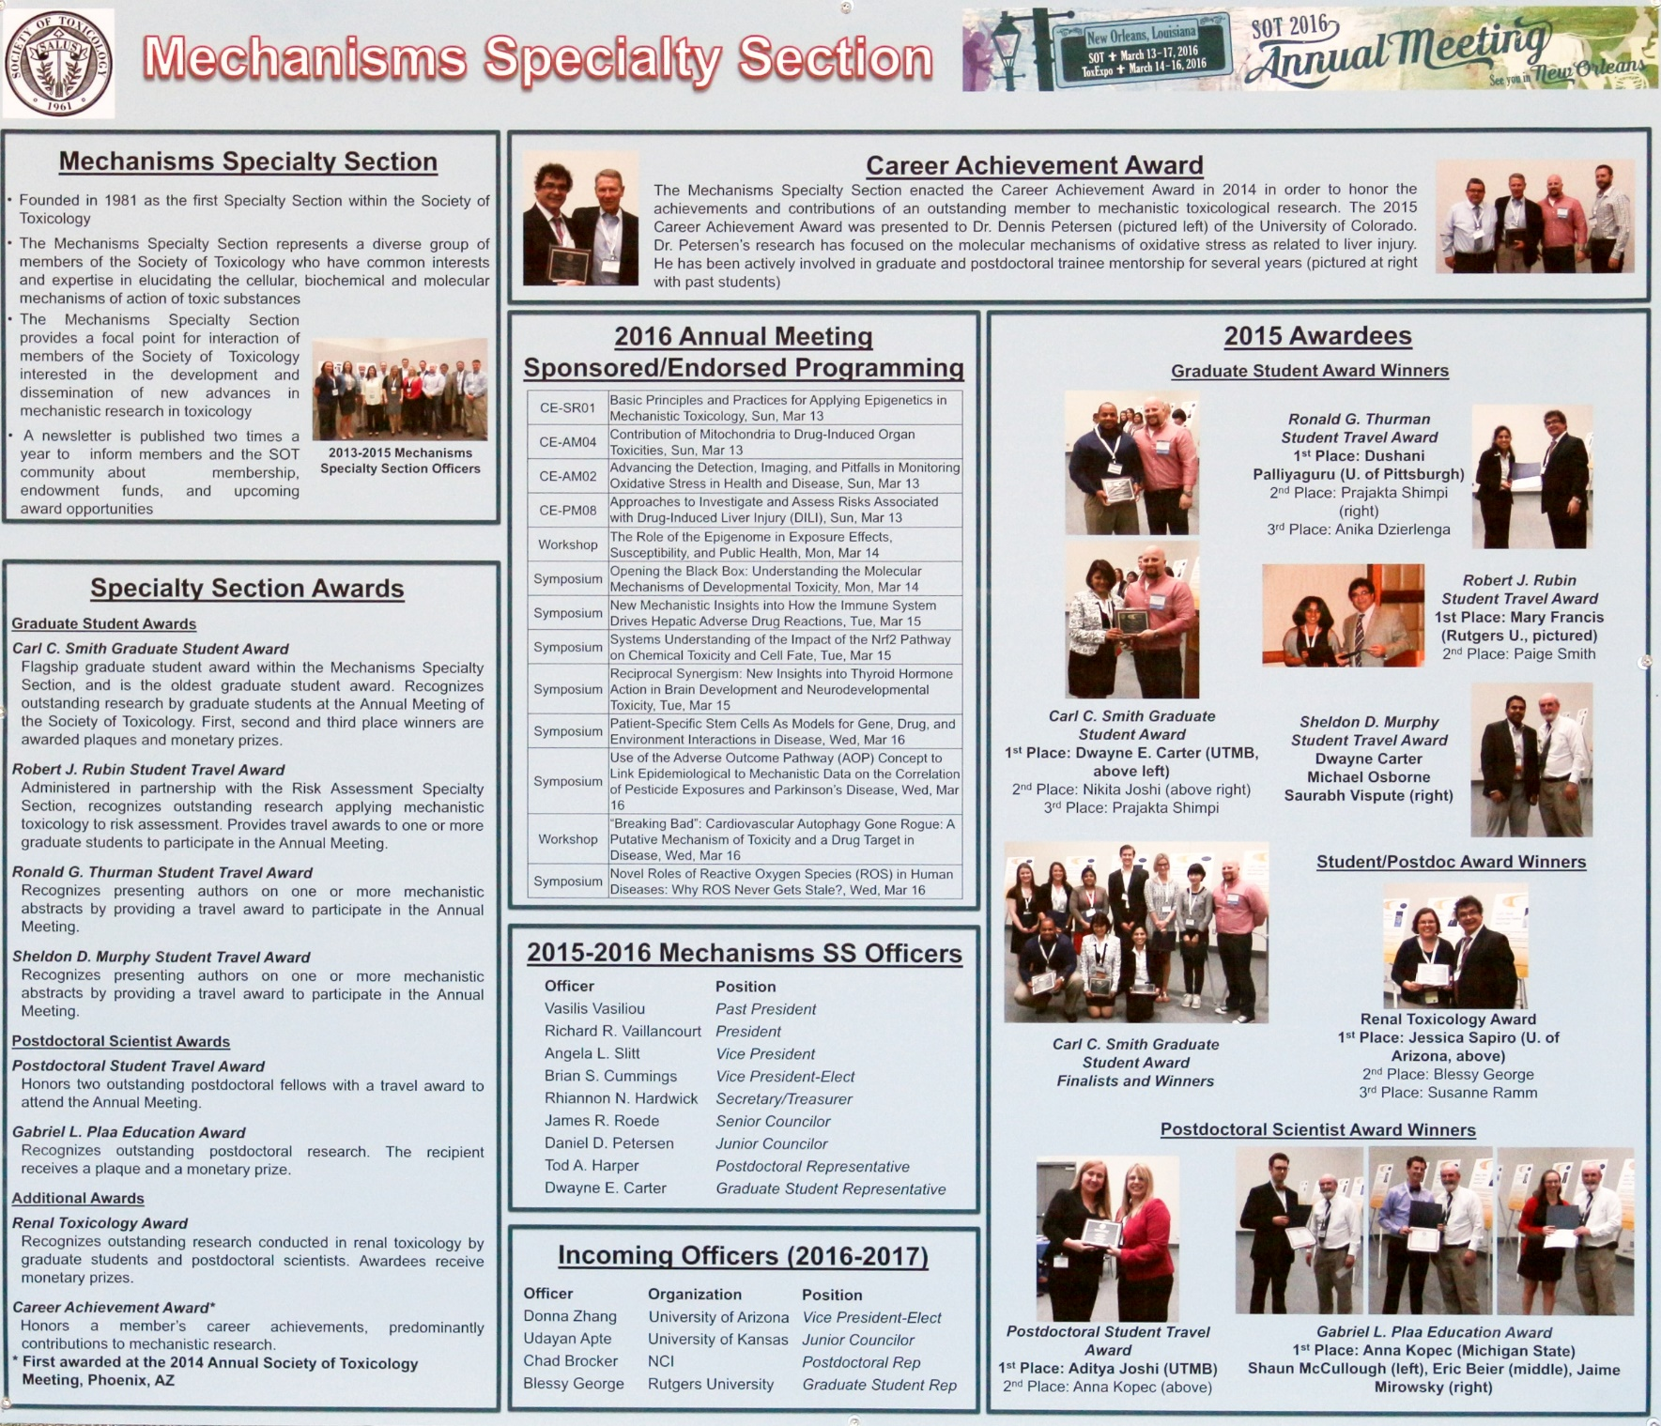

Slide 4
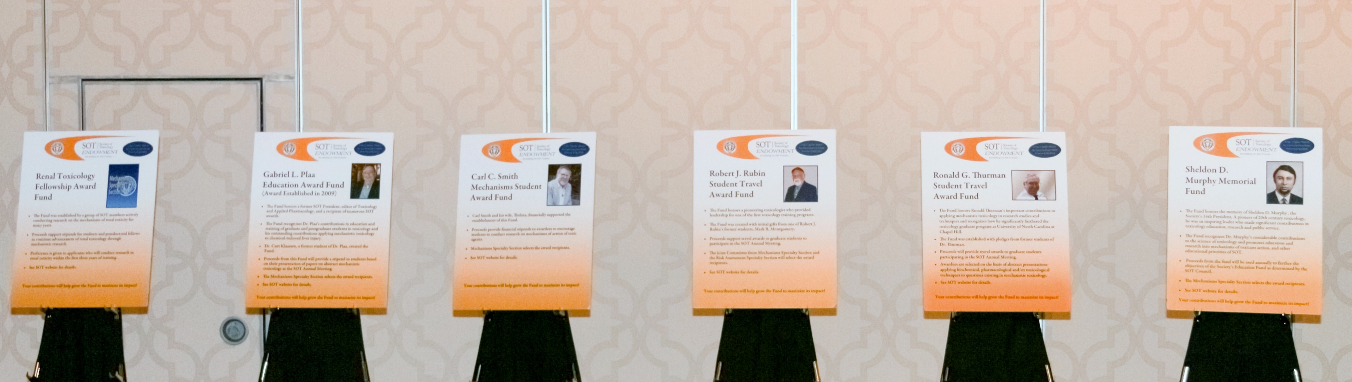

Slide 5
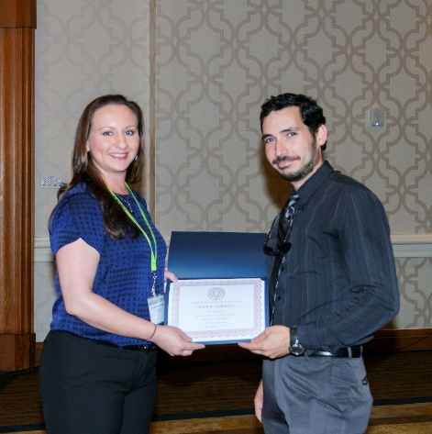
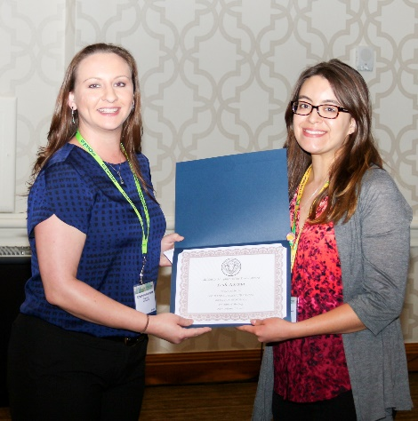
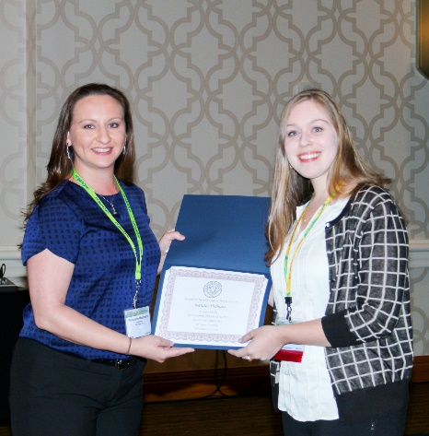
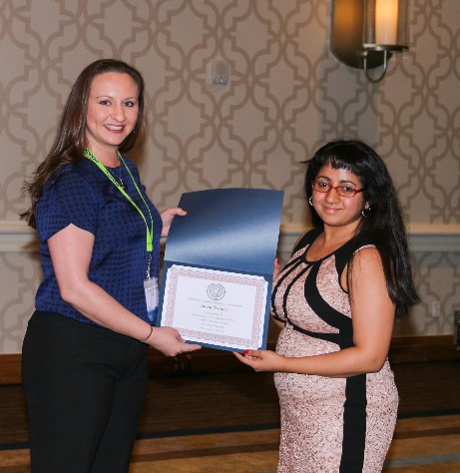
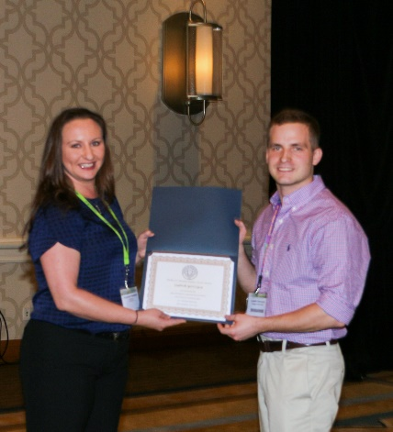
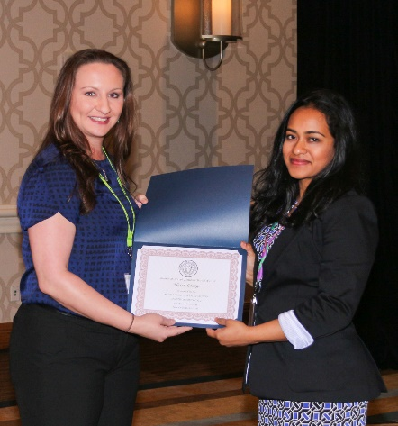
Sheldon D. Murphy Student Travel Award
Presented by Secretary/Treasurer Rhiannon Hardwick, Organovo
Aram Cholanians,
University of Arizona
Arsenic Induces In Vitro and In Vivo Accumulation of Alpha-Synuclein: Implications in Parkinson’s Disease
Leah Norona,
University of North Carolina at Chapel Hill
Modeling Drug-Induced Hepatic Fibrosis In Vitro Using Three-Dimensional Liver Tissue Constructs
Natalie Holman,
University of North Carolina at Chapel Hill
Temporal and dose-dependent increases in exosomal RNA precede hepatocellular toxicity in human and rodent models of drug-induced liver injury
Mary Francis,
Rutgers University
Regulation of Macrophage Accumulation an dActivation in the Lung Following Ozone Exposure by the Farnesoid X Receptor
Ludwick Gorzcyca, Rutgers University
Differential Regulation of Human Placental Transporters During Hypoxia
Blessy George,
Rutgers University
Increased Tubular Dysfunction and Injury Response in Biomarkers in the Absence of Overt Clinical Nephrotoxicity in Cancer Patients Receiving Cisplatin Therapy

Slide 6
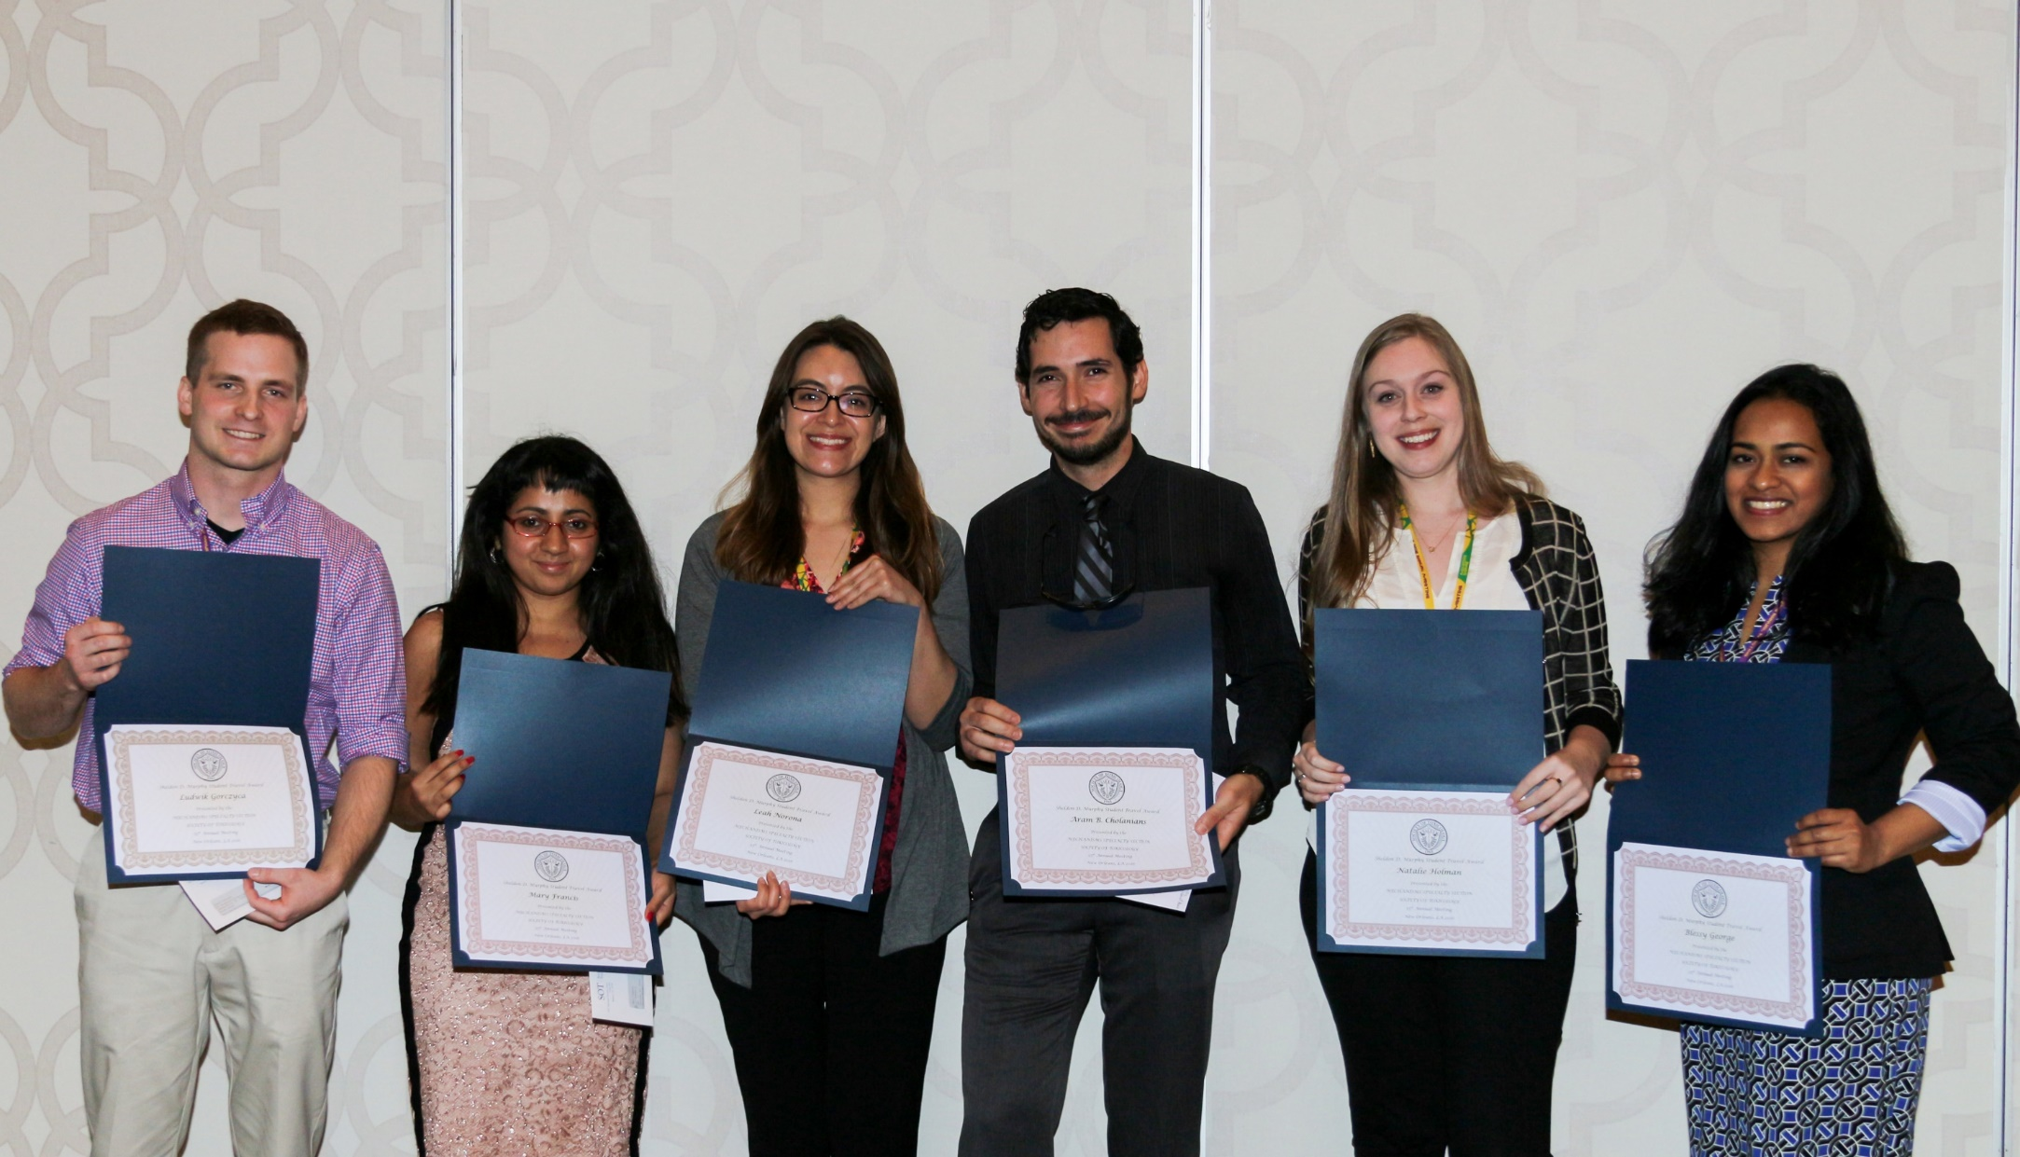
Sheldon D. Murphy Travel Award

Slide 7
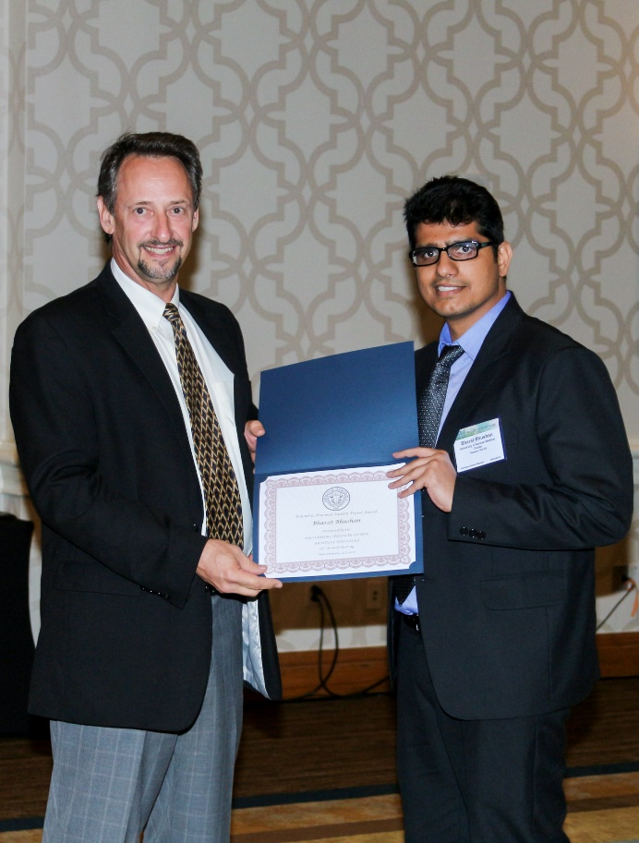
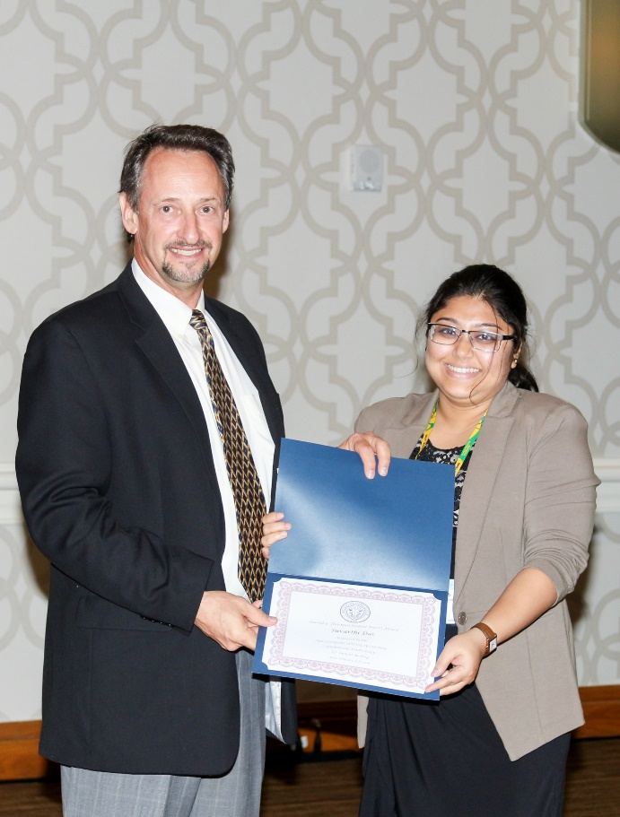
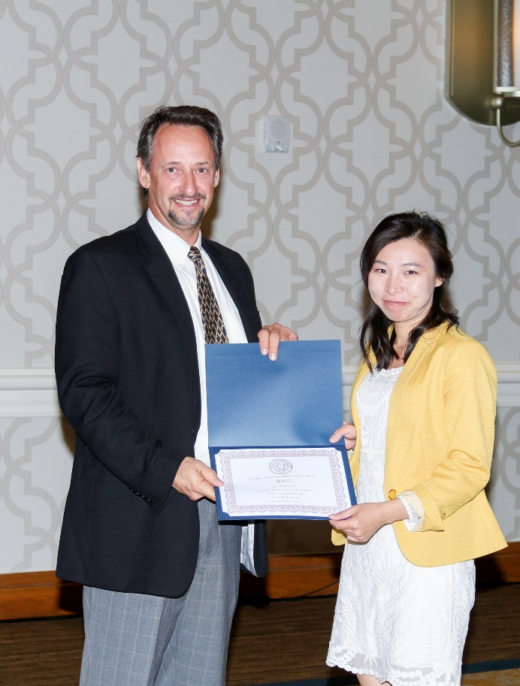
Ronald G. Thurman Student Travel Award
Presented by President Richard Vaillancourt, University of Arizona
Bharat Bhushan,
University of Kansas
Dual Role of Epidermal Growth Factor Receptor (EGFR) Signaling in Acetaminophen-Induced Liver Injury and Regeneration
Suvarthi Das,
University of South Carolina
CYP2E1-mediated Oxidative Stress Regulates MyD88 Expression and Function in Toxin Potentiation of Nonalcoholic Steatohepatitis
Hui Li,
University of Arizona
Nonalcoholic Steatohepatitis Alters Cytochrome P450 Activity in Pediatric Patients

Slide 8
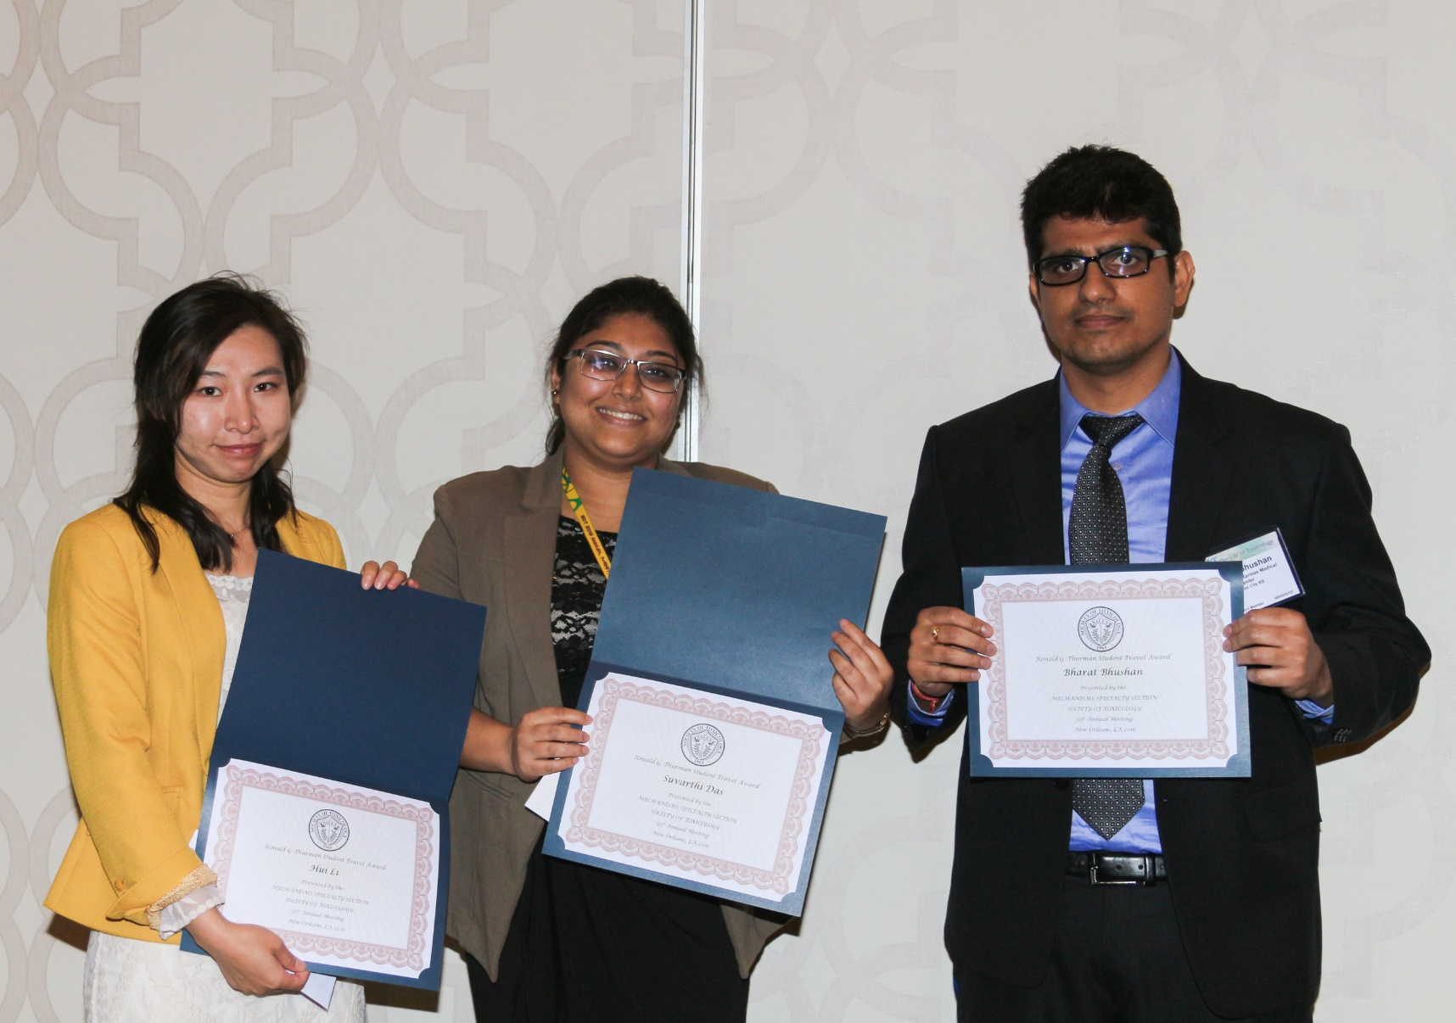
Ronald G. Thurman Student Travel Award

Slide 9
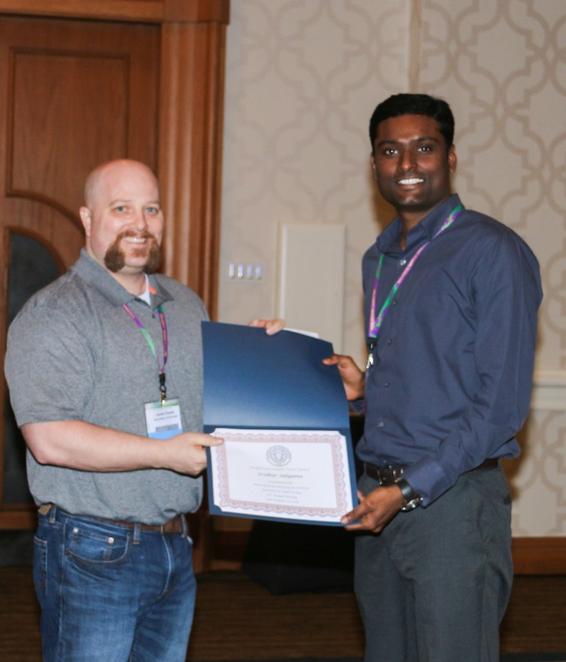
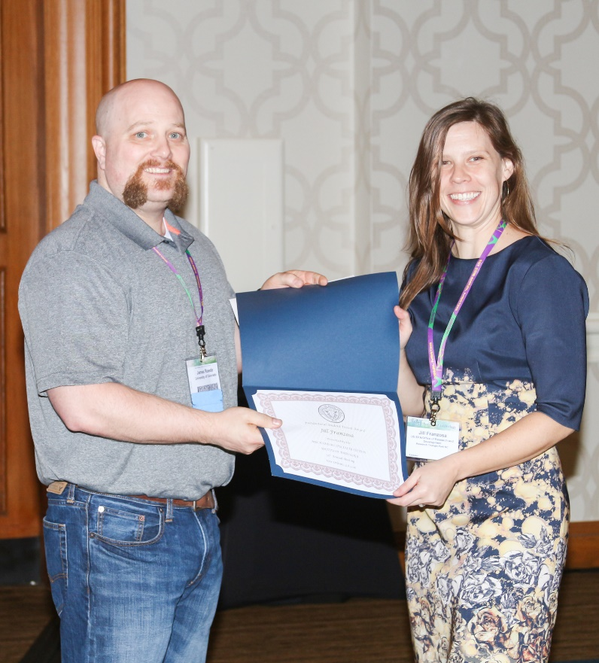
Postdoctoral Student Travel Award
Presented by Senior Councilor James Roede, University of Colorado
Sridhar Jaligama,
University of Tennessee
Regulatory T cells and IL10 suppress pulmonary host defense during early life exposure to radical containing ultra fine particulate matter
Jill Franzosa,
USEPA
Prediction of in vivo hepatotoxicity using in vitro transcriptomic data

Slide 10
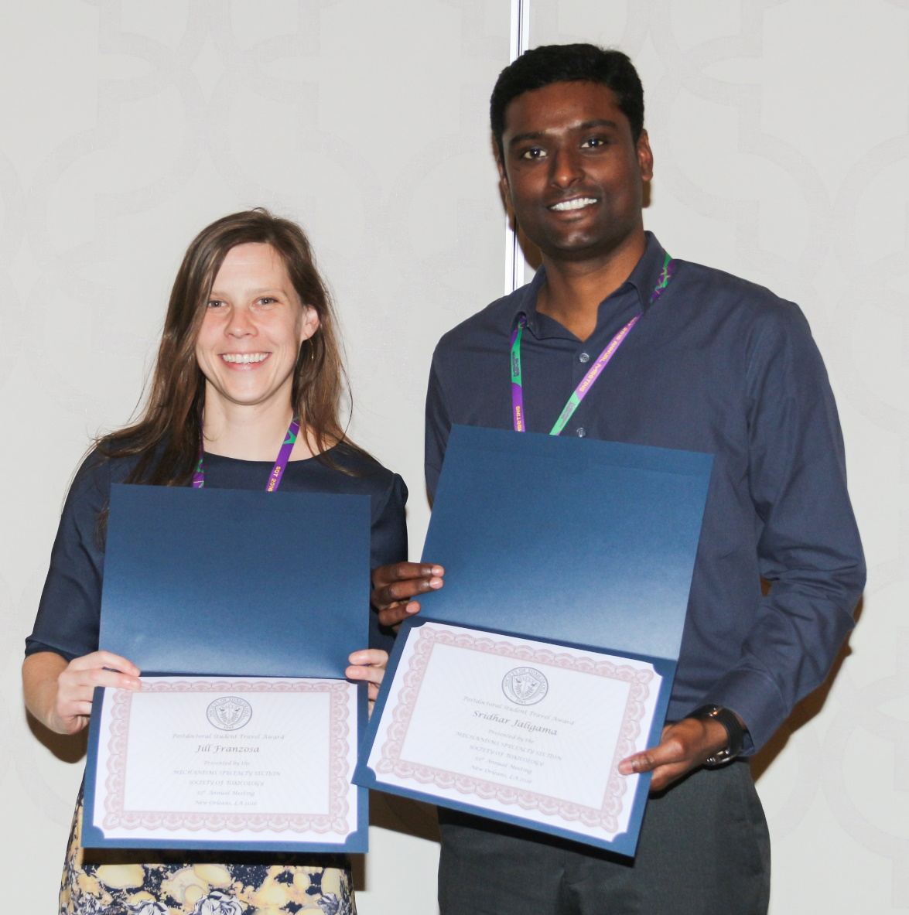
Postdoctoral Student Travel Award

Slide 11
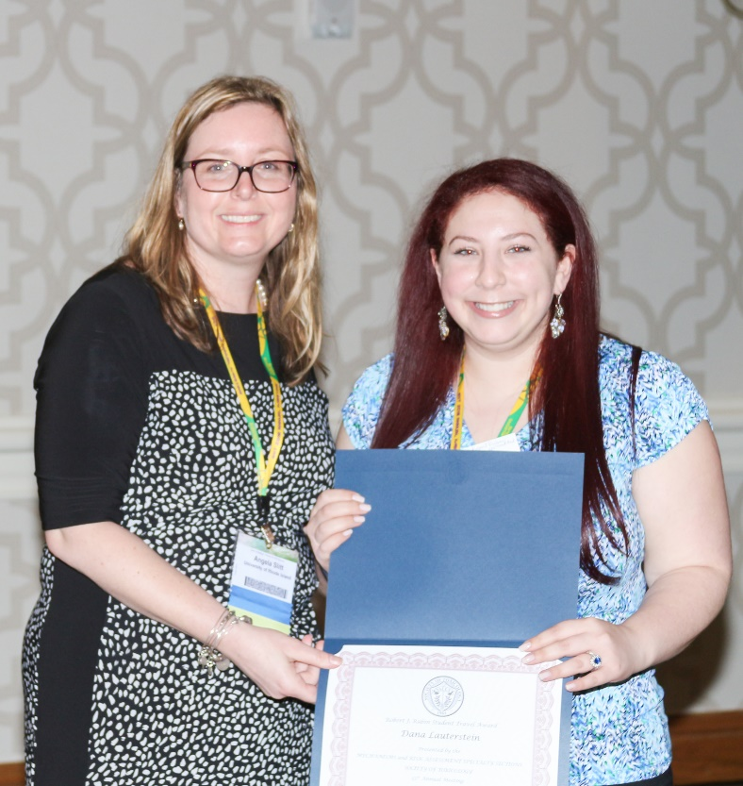
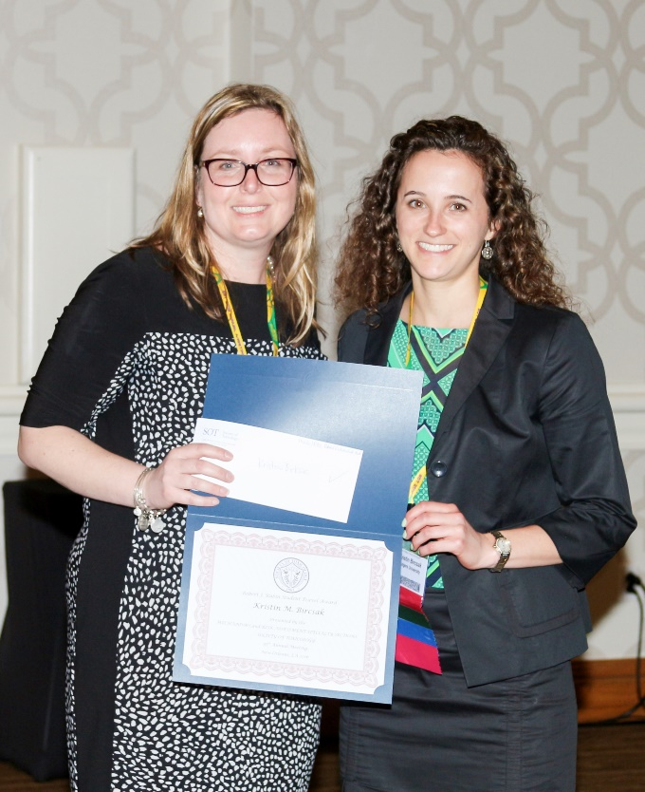
Robert J. Rubin Student Travel Award
Jointly administered by Risk Assessment and Mechanisms
Presented by Vice President Angela Slitt, University of Rhode Island
Dana Lauterstein,
New York University
E-cigarette Exposure Induces Neuro-alterations in Mice Exposed During Early Life
Kristin Bircsak,
Rutgers University
Interindividual Regulation of the BCRP/ABCG2 Transporter in Human Term Placentas

Slide 12
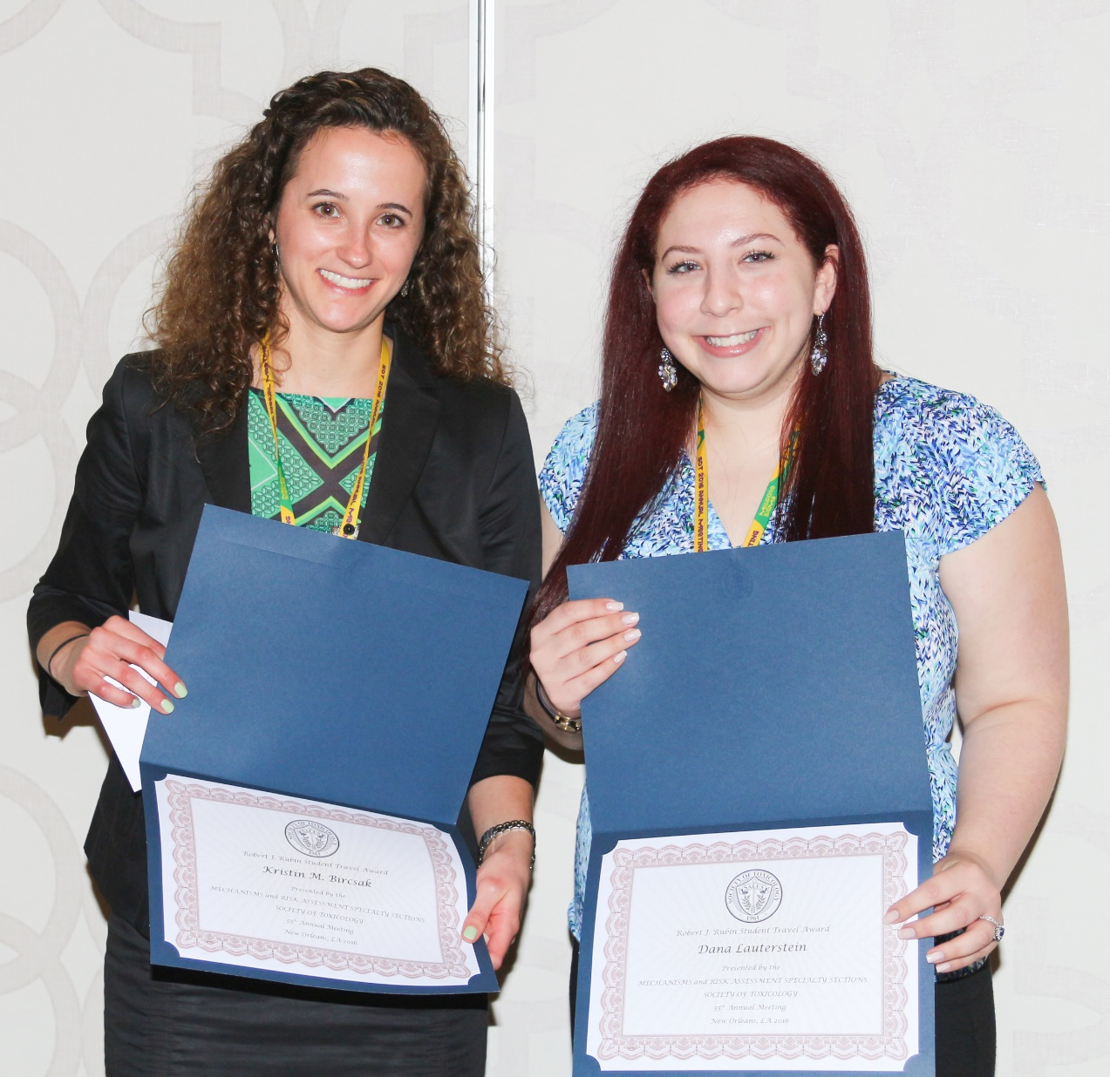
Robert J. Rubin Student Travel Award

Slide 13
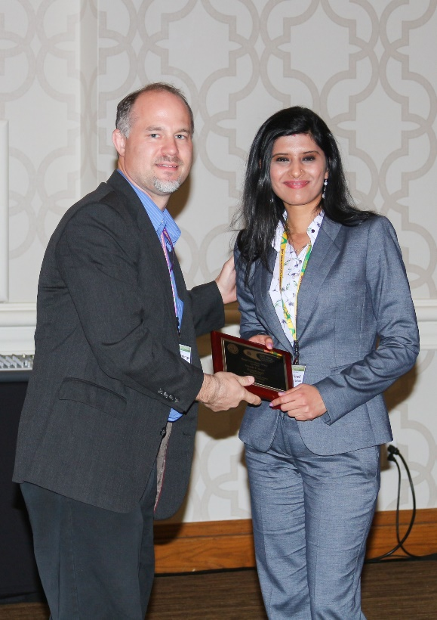
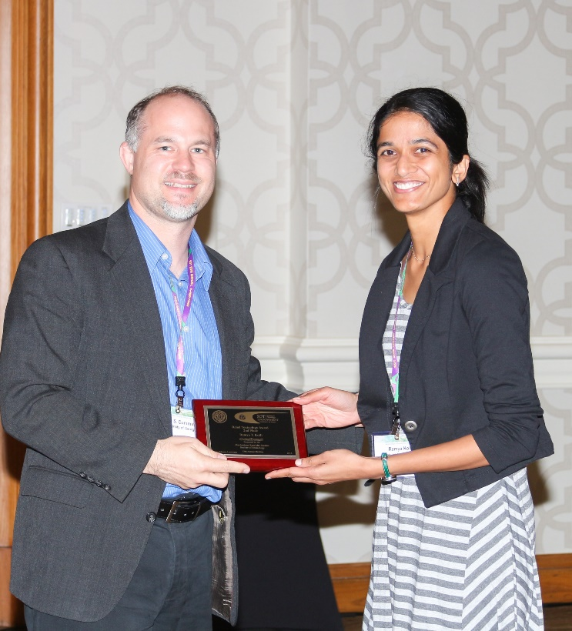
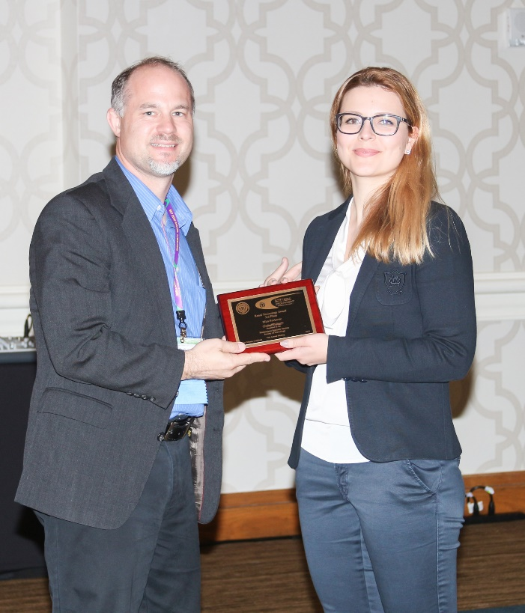
Renal Toxicology Award
Presented by Vice President-Elect Brian Cummings, University of Georgia
1st Place:
Priyanka Trivedi,
Harvard Medical School
Mechanistic role of phospholipase D4 in regulating kidney fibrosis
2nd Place:
Ramya Kolli,
University of Georgia
Bromate Induced Alterations in the Renal Expression of Cyclin-Dependent Kinase Inhibitors via Epigenetic Mechanisms
3rd Place:
Mira Pavkovic,
Harvard Medical School
Early, Sensitive and Mechanistic Detection of Drug-Induced Kidney Injury in Humans using Urinary KIM-1, miR-21, -200c, and -423

Slide 14
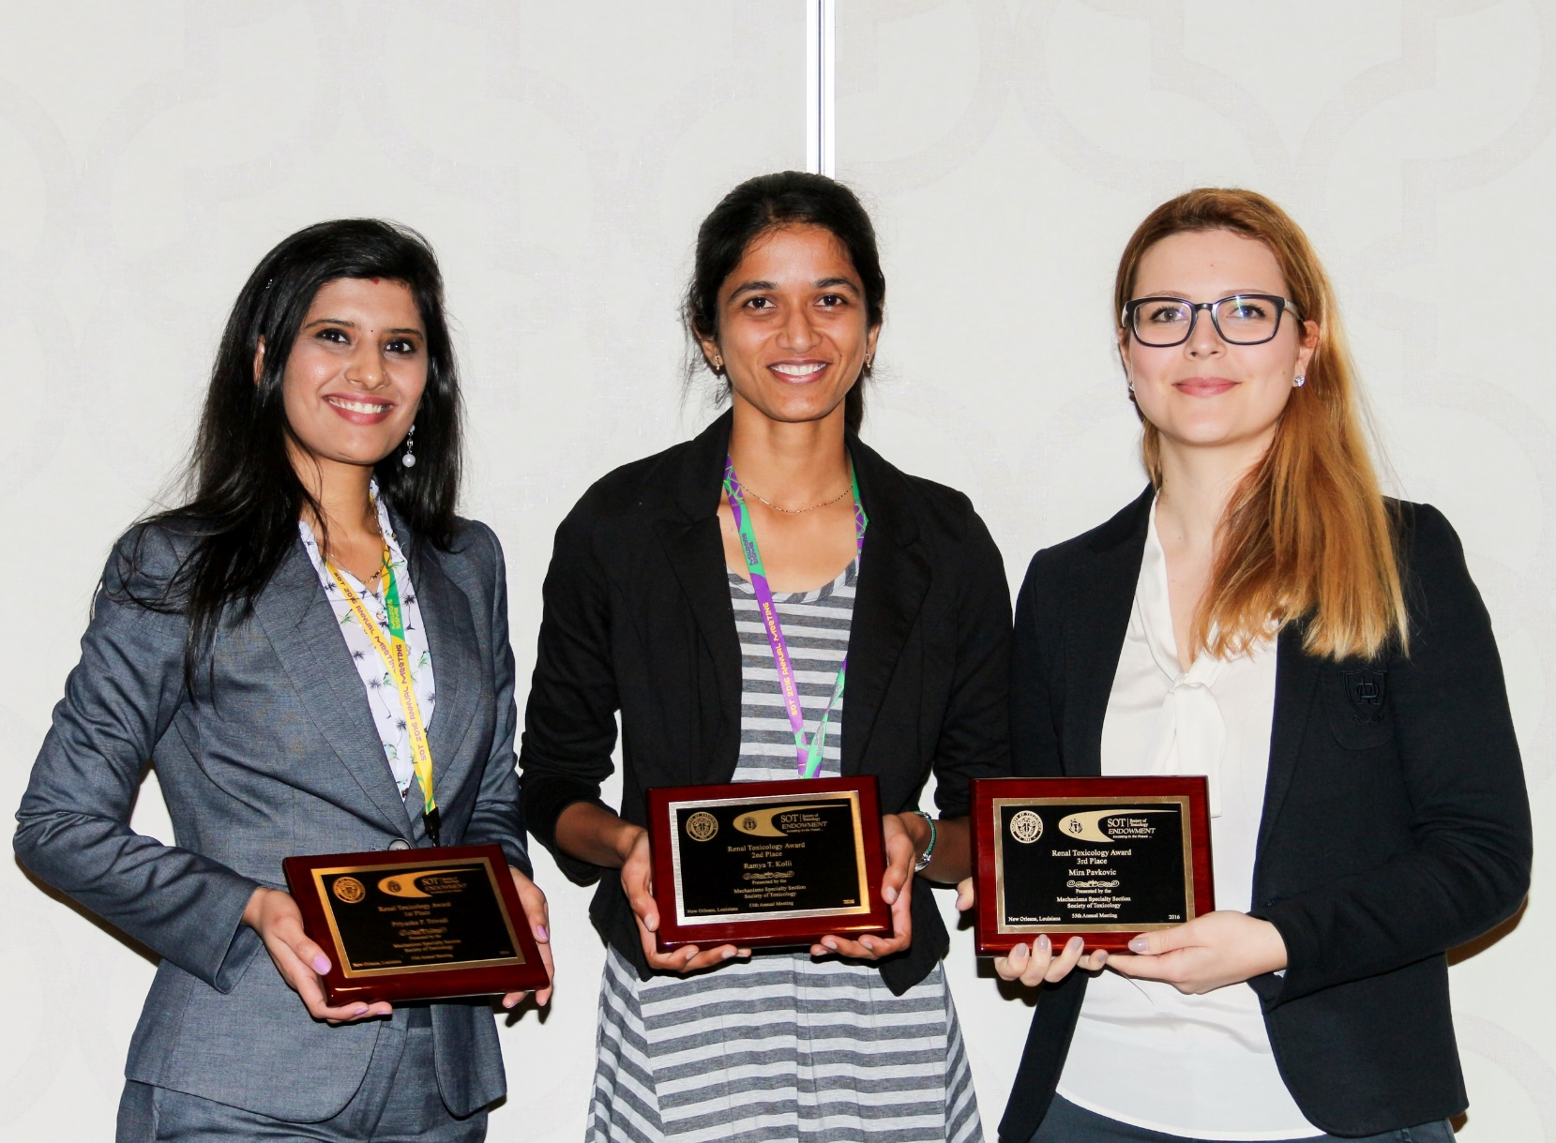
Renal Toxicology Award

Slide 15
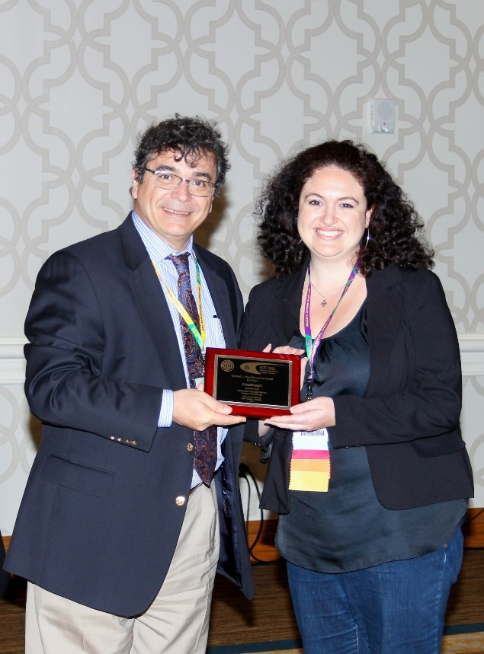
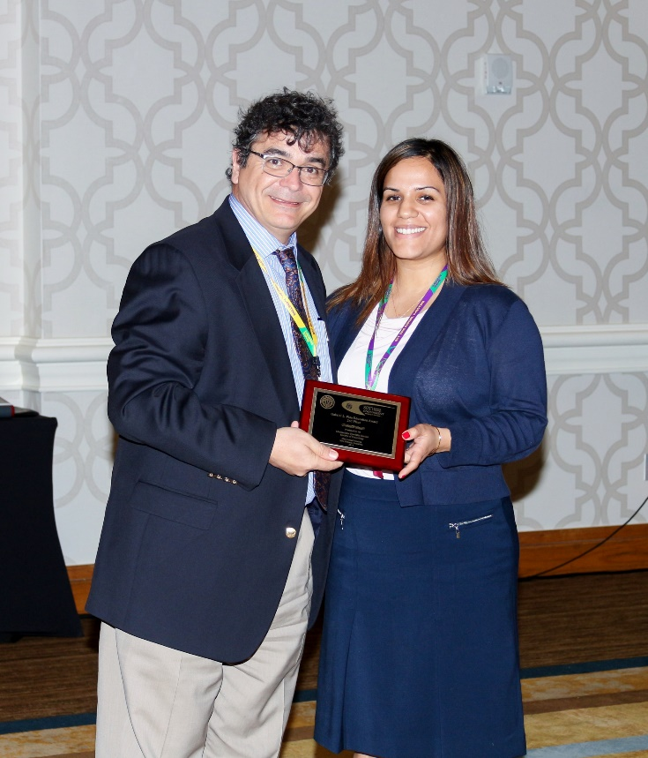
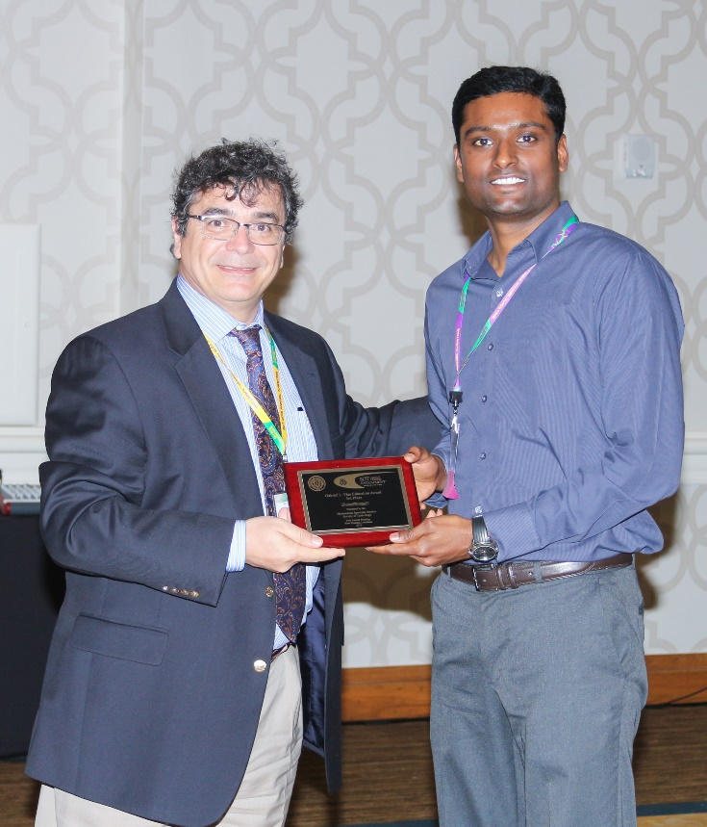
Gabriel L. Plaa Education Award
Presented by Past President Vasilis Vasiliou, Yale University
1st Place:
Karilyn Sant,
Umass-Amherst
Perfluorooctanesulfonic Acid (PFOS) Alters Organogenesis and Embryonic Redox Signaling in the Zebrafish, Danio rerio
2nd Place:
Nicole Olgun,
NIOSH
Comparison of the Toxicity of Sintered vs Unsintered Indium-Tin Oxide Particles on Murine Macrophage and Epidermal Cells
3rd Place:
Sridhar Jaligama,
University of Tennessee
Regulatory T Cells and IL10 Suppress Pulmonary Host Defense during Early Life Exposure to Radical Containing Ultrafine Particulate Matter

Slide 16
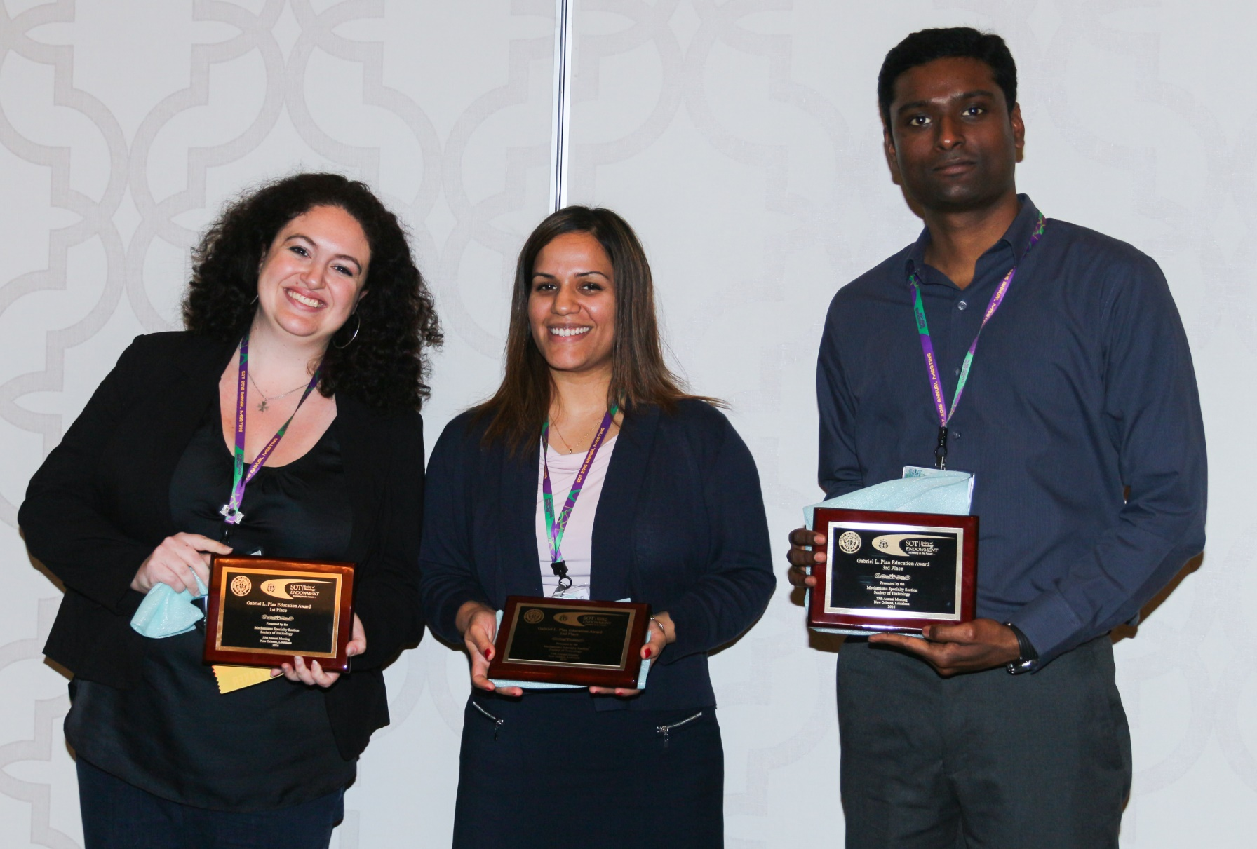
Gabriel L. Plaa Education Award

Slide 17
Carl C. Smith Graduate Student Award
Presented by Junior Councilor Daniel Petersen, USEPA
Finalists:
Bharat Bhushan, University of Kansas
Shirley (Shih-Yu) Chang, University of Washington
Aram Cholanians, University of Arizona
Vivekkumar Dadhania, University of Louisiana at Monroe
Shivani Ghaisas, Iowa State University
Tiffani Hargraves, University of Arizona
Natalie Holman, University of North Carolina at Chapel Hill
Nikita Joshi, Michigan State University
Vivek Lawana, Iowa State University
Pankajimi Mallick, University of Houston
Pallavi McElroy, University of Colorado Anschutz Medical Campus
Rance Nault, Michigan State University

Slide 18
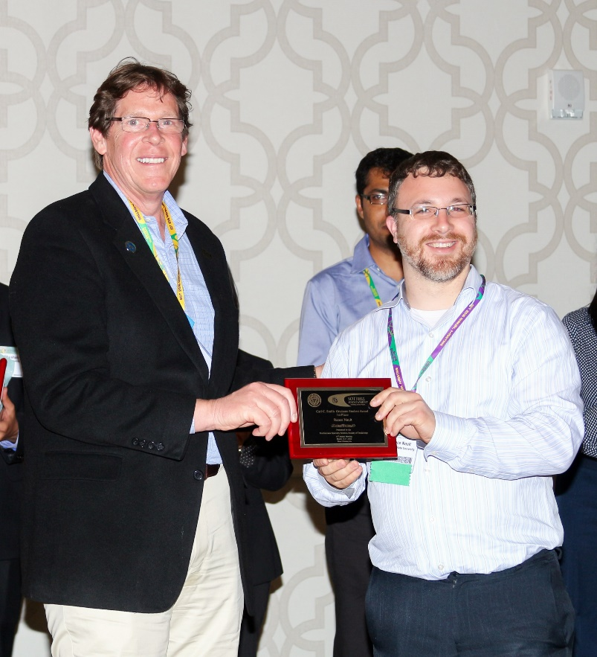
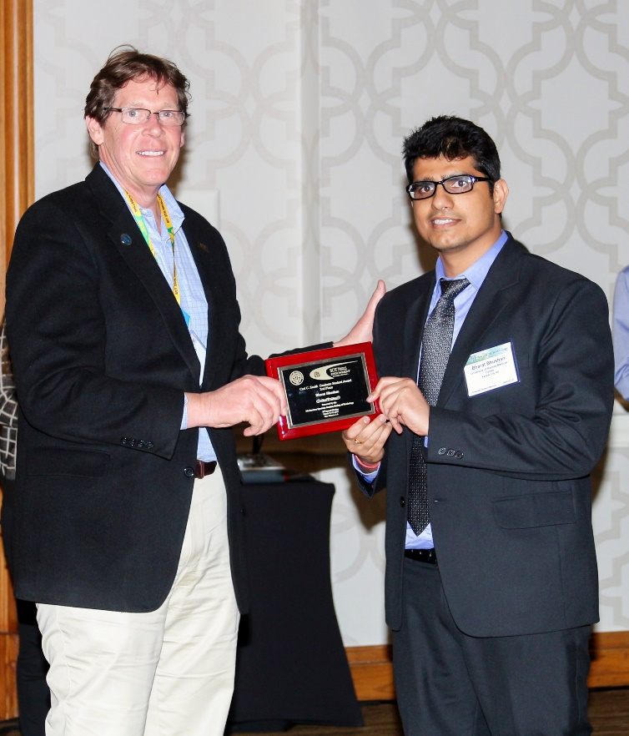
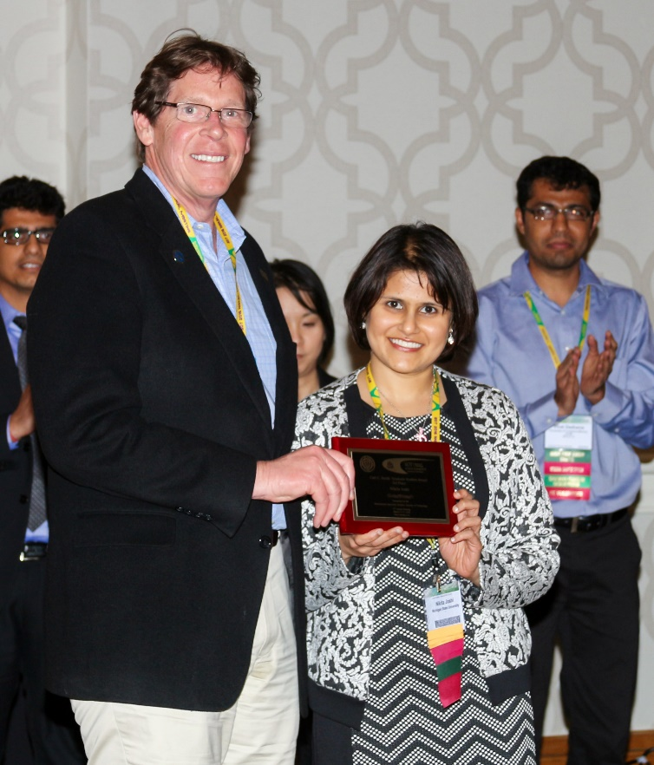
Carl C. Smith Graduate Student Award
Presented by Junior Councilor Daniel Petersen, USEPA
1st Place:
Rance Nault,
Michigan State University
Pyruvate Kinase Isoform Switching and Hepatic Metabolic Reprogramming by the Environmental Contaminant 2,3,7,8-Tetrachlorodibenzo-p-Dioxin
2nd Place:
Bharat Bhushan,
University of Kansas
Dual Role of Epidermal Growth Factor Receptor (EGFR) Signaling in Acetaminophen-Induced Liver Injury and Regeneration
3rd Place:
Nikita Joshi,
Michigan State University
Fibrin deposition following bile duct injury limits fibrosis through an αMβ2-dependent mechanism

Slide 19
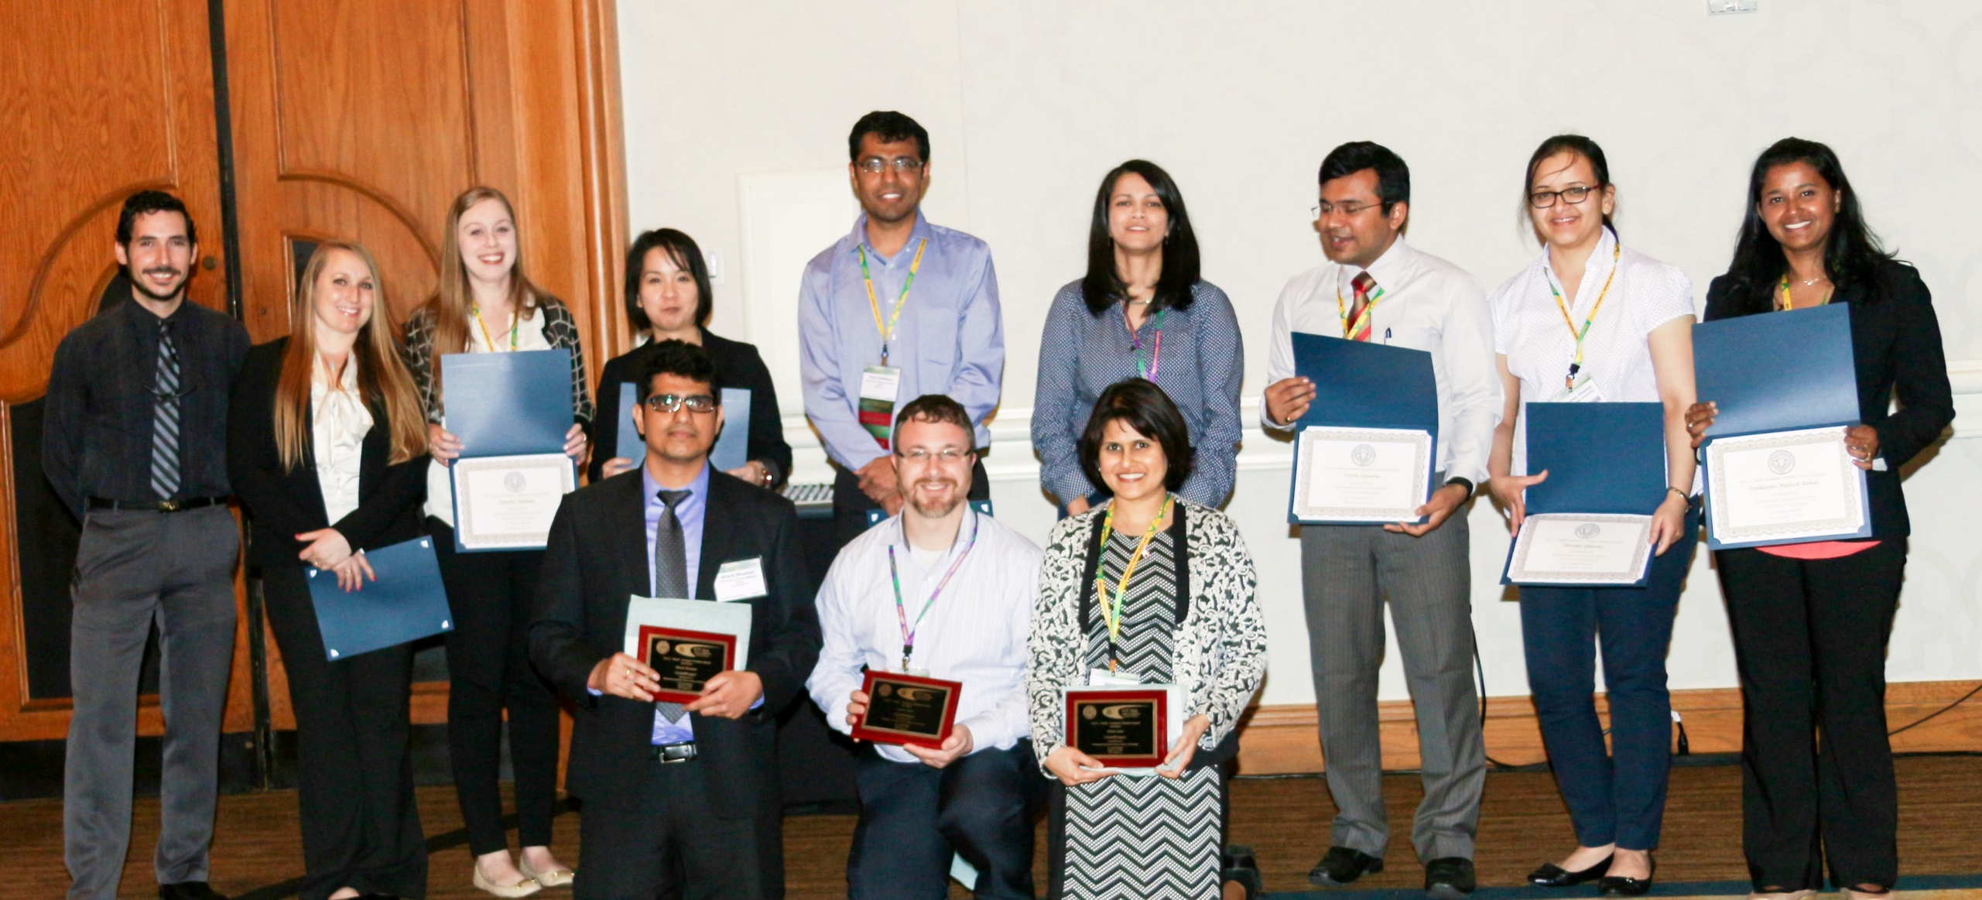
Carl C. Smith Graduate Student Award

Slide 20
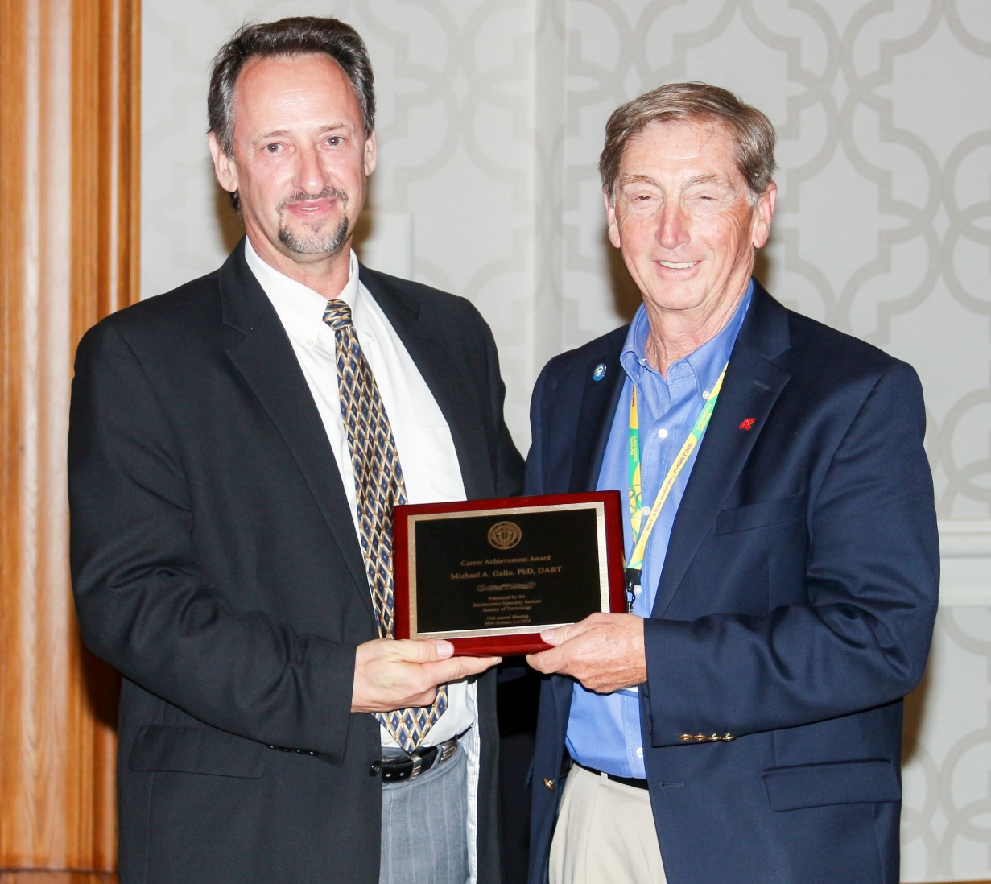
2016 Mechanisms Career Achievement Award
Presented by President Richard Vaillancourt, University of Arizona
Michael A. Gallo, PhD, DABT, Fellow ATS
Rutgers University

